Slide 1
Java 9
@JUGArgentina
meetup/jugargentina
#buenos-aires-tech

Slide 2


Quien soy
jooby.org @joobyproject
15+ Software Engineer
@edgarespina
J. Walter Thompson
Java User Group Argentina
Notes:
Yo soy Rudolph Giuliani, hagan lo que yo ordene, cero tolerancia

Slide 3
Agenda
Modules / Jigsaw
Minor languages improvements
New APIs and tools
Future of Java

Slide 4
Jigsaw goal
Strong encapsulation
Loose coupling
Modularity and dependency discover at compile time
Modularize JDK
Safe classpath (no classpath hell and shadowing of classes)
Scalable runtimes for small devices

Slide 5
Jigsaw history
9-10 years of work (https://mreinhold.org/blog)
Initially scheduled for JDK 7, JDK 8, JDK 9 (delayed twice)
Release date: September 21th

Slide 6
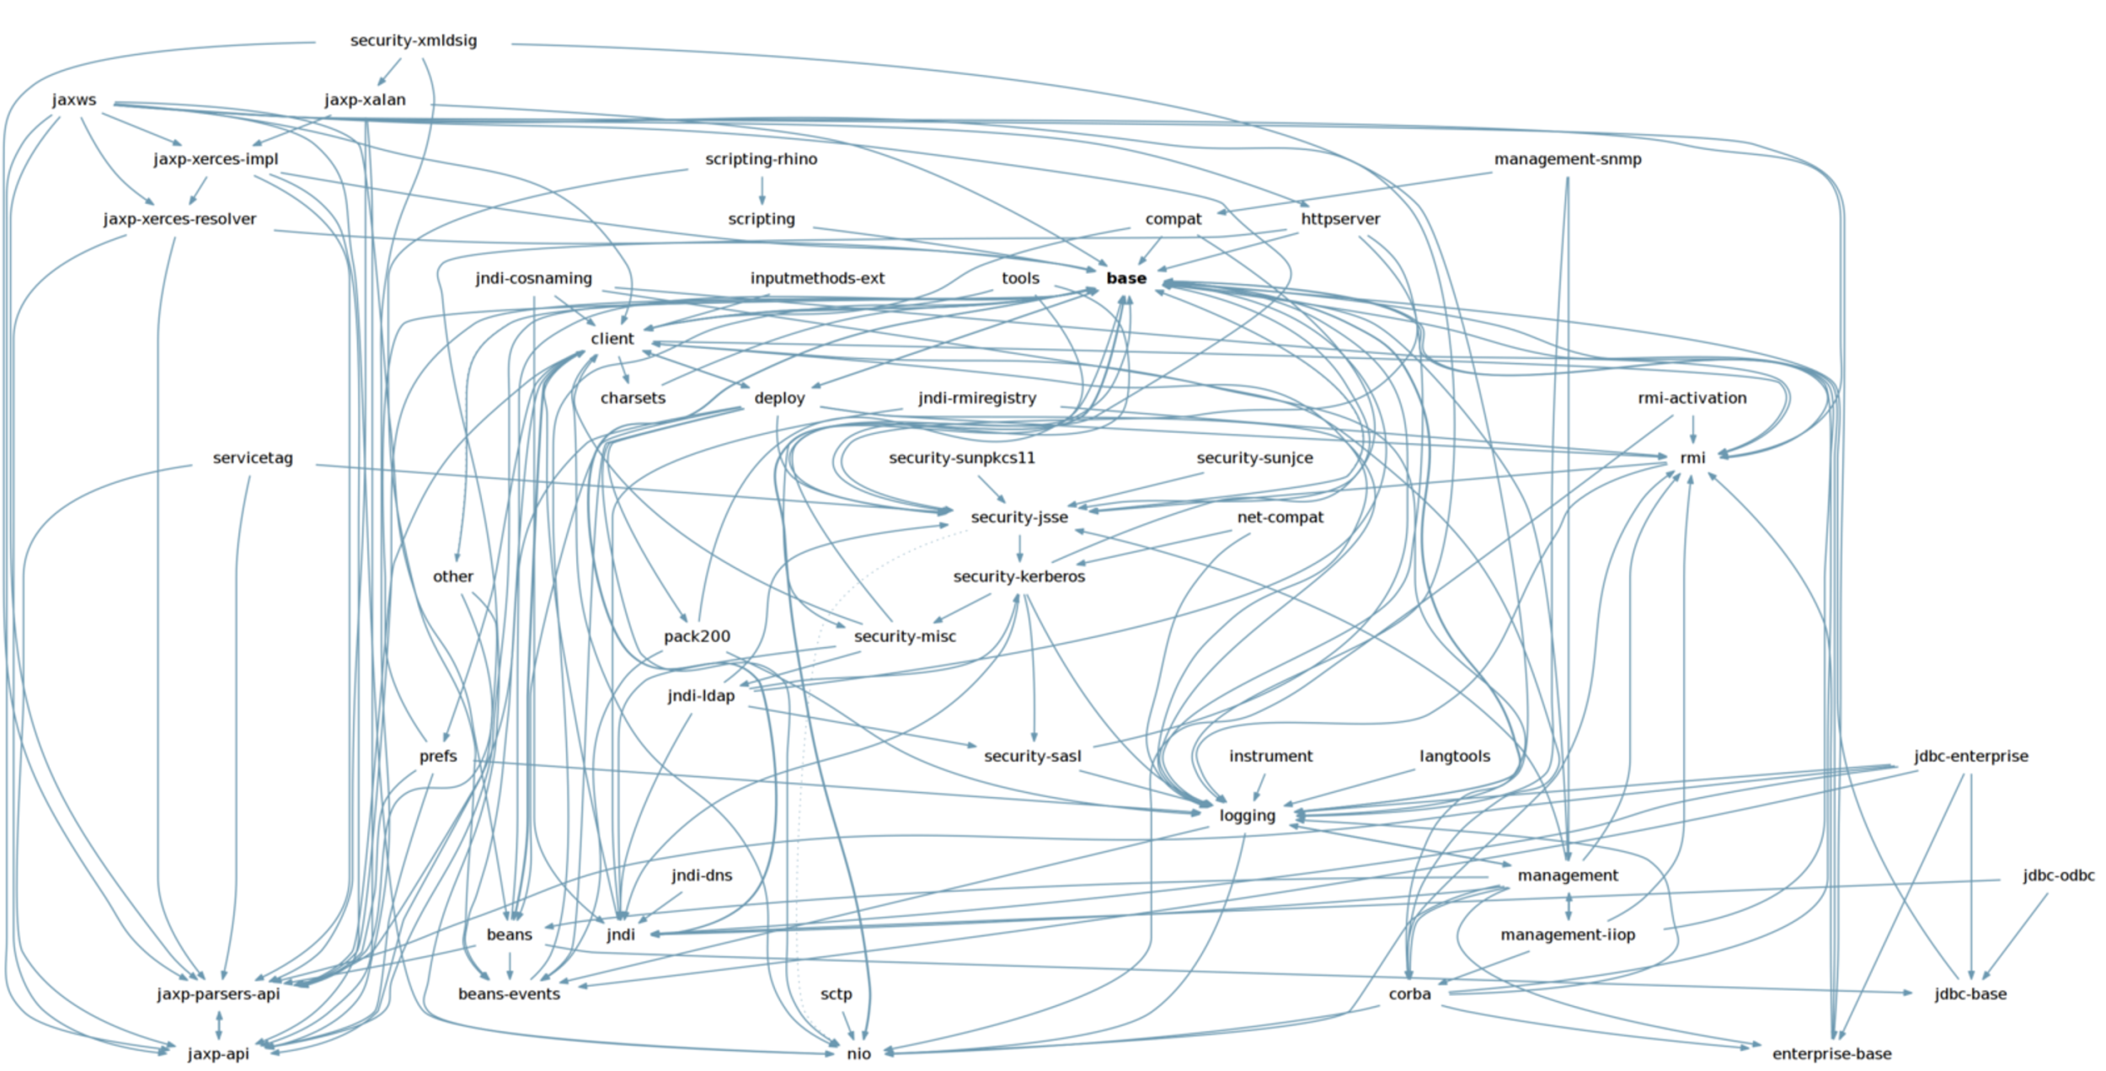
Jigsaw: JDK back in 2010

Slide 7
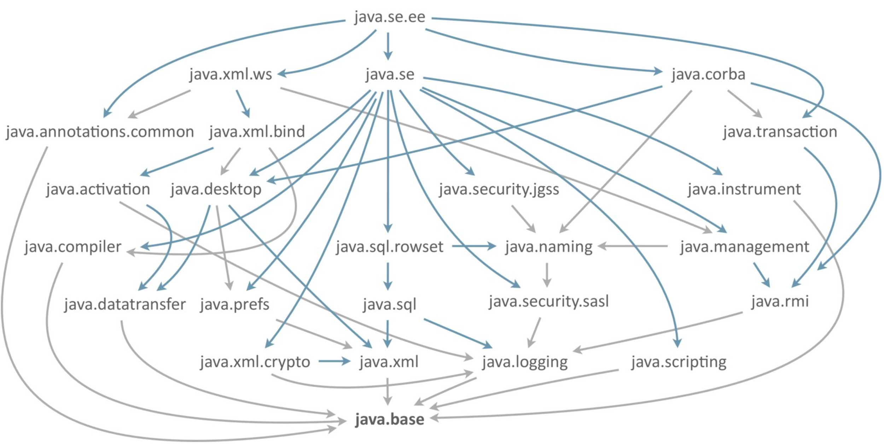
Jigsaw: JDK today

Slide 8
Jigsaw: module
Collection of packages
Jar file with a module-info class file
Accessible or required services and packages must be declared explicitly
Compiled

Slide 9
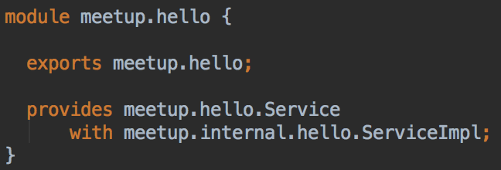
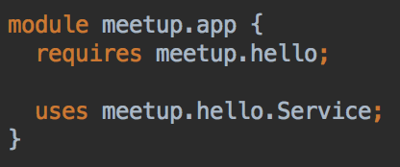
Jigsaw: module-info.java

Slide 10
Jigsaw: running a module
java -p mod1.jar:mod2.jar -m mod/mainClass
-p or --module-path defines the module classpath
-m defines the main class in a module
still possible to use -p with -cp

Slide 11
Jigsaw: module types
Application
module-info.java
Automatic
no module-info.java, name is inferred from file name
Unamed
Every class defined via -cp
Platform
JDK module, like java.base, java.jdbc

Slide 12
Jigsaw: jlink
Application
module-info.java
Automatic
no module-info.java, name is inferred from file name
Unamed
Every class defined via -cp
Platform
JDK module, like java.base, java.jdbc

Slide 13
Jigsaw: (some) alternatives
OSGi
Powerful but complex
Eclipse Equinox, Apache Felix, etc.
Good documentation
No compiler
jboss-modules
Base for Wildfly (jboss server)
Easier than OSGi, still OSGi implementor
No documentation
No compiler
Release date: September 21th

Slide 14
Jigsaw: migration
Automatic and the unnamed module
java.lang.invoke.VarHandle as alternative to sun.misc.Unsafe
The big kill switch: --permit-illegal-access (only for 9, won’t work on 10)
-m defines the main class in a module
still possible to use -p with -cp

Slide 15
jshell
Finally a REPL console for Java
Ideally for learn, test and fast-prototyping
No need of Java file, compiler or IDE

Slide 16
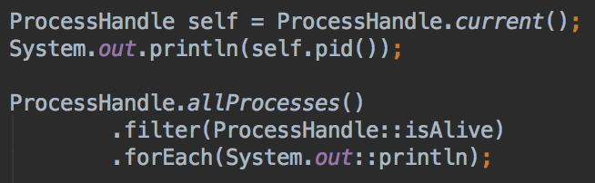
Process API
Portable process management API
Current, children, spawned and system processes

Slide 17
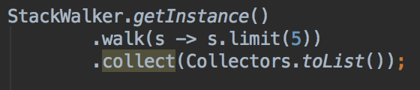
StackWalker API
Access to stack trace via StakWalker API
No need to create an Exception

Slide 18
Minor changes
Private method for interfaces
Underscore for lambda arguments
Publish/Subscribe API (Rxjava 2, Reactor)
Immutable collection factory methods:
List.of(1, 2, 3)
Set.of(“a”, “b”, “c”)

Slide 19
Future of Java
Type inference for local variables
var foo = new Foo();
Data classes and Value Objects:
value Point {int x; int y}
Pattern matching
* https://www.youtube.com/watch?v=oGll155-vuQ
* http://cr.openjdk.java.net/~briangoetz/amber/pattern-match.html
* http://openjdk.java.net/jeps/169

Slide 20
Preguntas?
Demo: https://github.com/jugargentina/java9-meetup
Gracias
@JUGArgentina
meetup/jugargentina
#buenos-aires-tech

